Slide 1


PagedAttention & vLLM
COMS 6998 · AI-NATIVE COMPUTING · WEEK 3 — SERVING SYSTEMS FOR LLMS
Efficient memory management for LLM serving — and where the evidence falls short
Kwon, Li, Zhuang, Sheng, Zheng, Yu, Gonzalez, Zhang, Stoica
SOSP 2023 · arXiv:2309.06180 · paired with SGLang (NeurIPS 2024)
Presenter: Aaron Mano Cherian
Sep 25, 2026
Notes:
- Lots to cover: Marathon
- Henry VIII
- Project Title

Slide 2
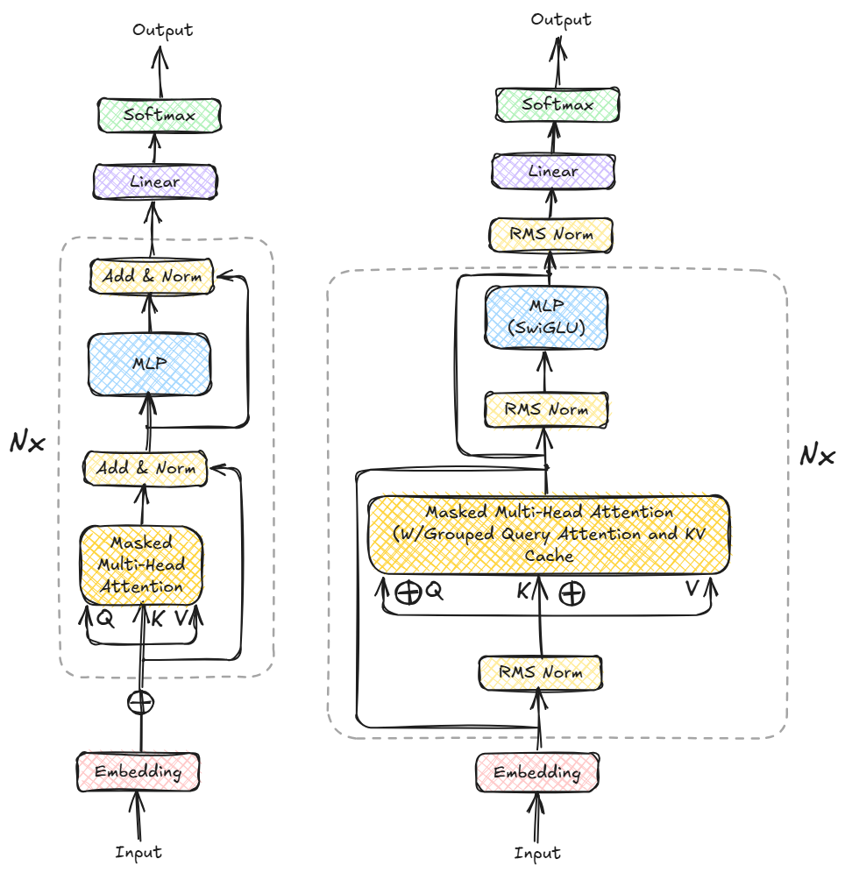
OPTIMIZATION! OPTIMIZATION! OPTIMIZATION!
Workflow-angle rather than single model
Embedding turns tokens into vectors
N × decoder block: masked self-attention (Q, K, V) + MLP, with norms and residuals
Linear + softmax give the next-token probabilities
Prefill
Decode
the prompt phase
the generation phase
Whole prompt in one forward pass
Matrix × matrix, so compute-bound
Writes K, V for every prompt token
Sets time-to-first-token (TTFT)
Autoregressive: one token per step
Matrix × vector, so memory-bound
Re-reads weights + all cached K, V
Sets inter-token latency (ITL)
Original decoder (left) vs. LLaMA-2 block with GQA + KV cache (right) · H. Elshafie, “Paged Attention from First Principles”
Decode dominates, so the fix is batching: many requests share one pass over the weights. Throughput now depends on how much KV cache fits in GPU memory.
02
Notes:
Quick primer, ~45 s. Every modern LLM is a decoder-only transformer: embed tokens, run them through N identical blocks (attention + MLP), then project to vocabulary probabilities. The right-hand diagram is the LLaMA-2 family: RMSNorm instead of LayerNorm, SwiGLU MLP, grouped-query attention, and a KV cache in the attention layer (diagram from H. Elshafie's 'Paged Attention from First Principles'). Point at GQA now - it returns in the critique: the paper evaluates only multi-head-attention models. Two phases: prefill processes the whole prompt in one forward pass with matrix-matrix multiplies (compute-bound, like training without backprop) and determines time-to-first-token. Decode generates one token per step - token t+1 cannot start until token t exists - with matrix-vector multiplies, re-reading all weights and the KV cache each step, so it is memory-bandwidth-bound and determines inter-token latency. Batching amortizes the weight traffic; Orca (OSDI 2022) added iteration-level (continuous) batching so requests join or leave after every step.

Slide 3
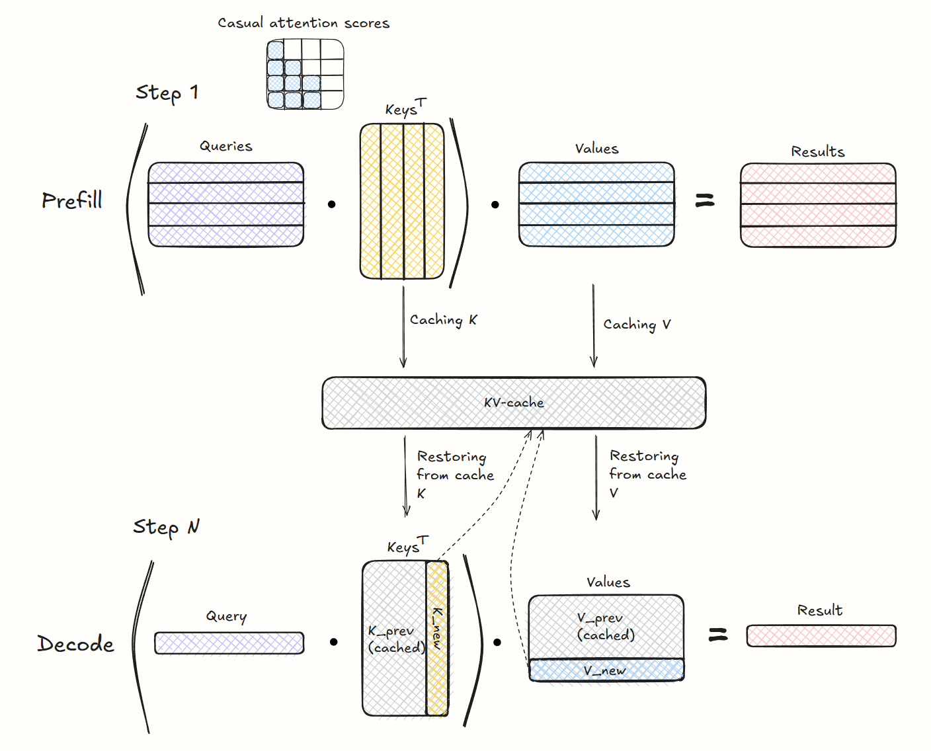

What is the KV cache?
A new token’s query attends to the keys and values of every earlier token
Past K, V never change, so compute once, cache, reuse
Prefill writes the cache; each decode step appends one entry per layer
Grows with every token, separately for every request
Stored contiguously: each request gets one unbroken block of GPU memory
Output length is unknown: the block is reserved for the max length, so most of it sits empty
KV bytes / token = 2 × layers × KV heads × head dim × bytes
03
Notes:
Autoregressive generation: token t attends to tokens 1..t-1. Their keys and values never change, so recomputing them each step wastes work - Elshafie's example: a 1,000-token prompt plus 100 output tokens needs ~100,000+ token computations without caching versus ~1,100 with it. So systems cache K and V for every token in every attention layer. The diagram: cached tokens (solid) supply K and V; the new token supplies only a query, then its own K and V are appended. The general size formula: 2 x layers x KV heads x head dim x bytes per element, times sequence length and batch size. For OPT-13B (MHA: 40 heads x 128 = 5120 hidden) that is ~800 KB per token. GQA/MQA/MLA shrink the 'KV heads' term - LLaMA-2-70B uses GQA - which matters for the critique later.

Slide 4
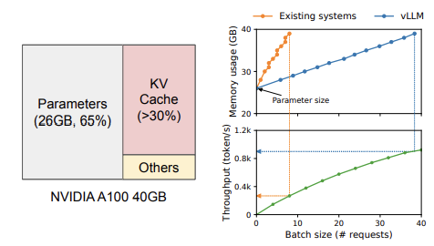
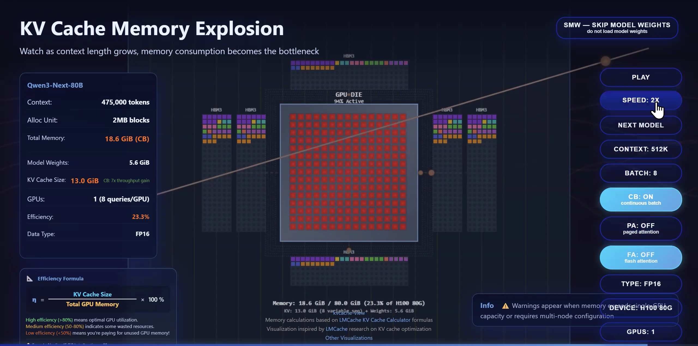
The KV cache outgrows the GPU
800 KB
1.6 GB
~12 GB
per token (OPT-13B, FP16)
per 2048-token sequence
left for KV on a 40 GB A100
12 GB ≈ 15.7K token slots, so only ~7 full-length requests fit, even packed perfectly
Fig. 1: weights 26 GB (65%), KV cache >30% · Kwon et al. 2023
Problem 1 · Waste
Contiguous, max-length pre-allocation: most reserved KV memory never holds a token (next slide)
Problem 2 · No sharing
Parallel samples, beams and common system prompts each keep their own copy of identical KV
Watch the KV cache explode: live demo (LMCache)
04
Notes:
Restaurant analogy (~30 s): existing systems seat every party at one long table sized for the largest party it could possibly be, because nobody knows how many friends will show up; most seats sit empty and new guests wait outside. vLLM seats parties at any free 4-seat tables, adds a table only when more friends arrive, and the host keeps a seating chart (the block table). Numbers (paper Section 3, Table 1): 2 (K,V) x 5120 hidden x 40 layers x 2 bytes = ~800 KB per token; 2048 tokens = ~1.6 GB. Weights take 26 GB (65%) of a 40 GB A100, leaving 12 GB = 15.7K KV slots, i.e. ~7 requests at full 2048-token length. Throughput is capped by KV capacity. It gets worse over time: A100 to H100 more than doubled FLOPS while memory stayed at 80 GB. Two problems follow: waste (next slide) and no sharing - overlapping KV from parallel sampling, beam search and shared prompts is duplicated because each sequence lives in its own contiguous buffer.

Slide 5
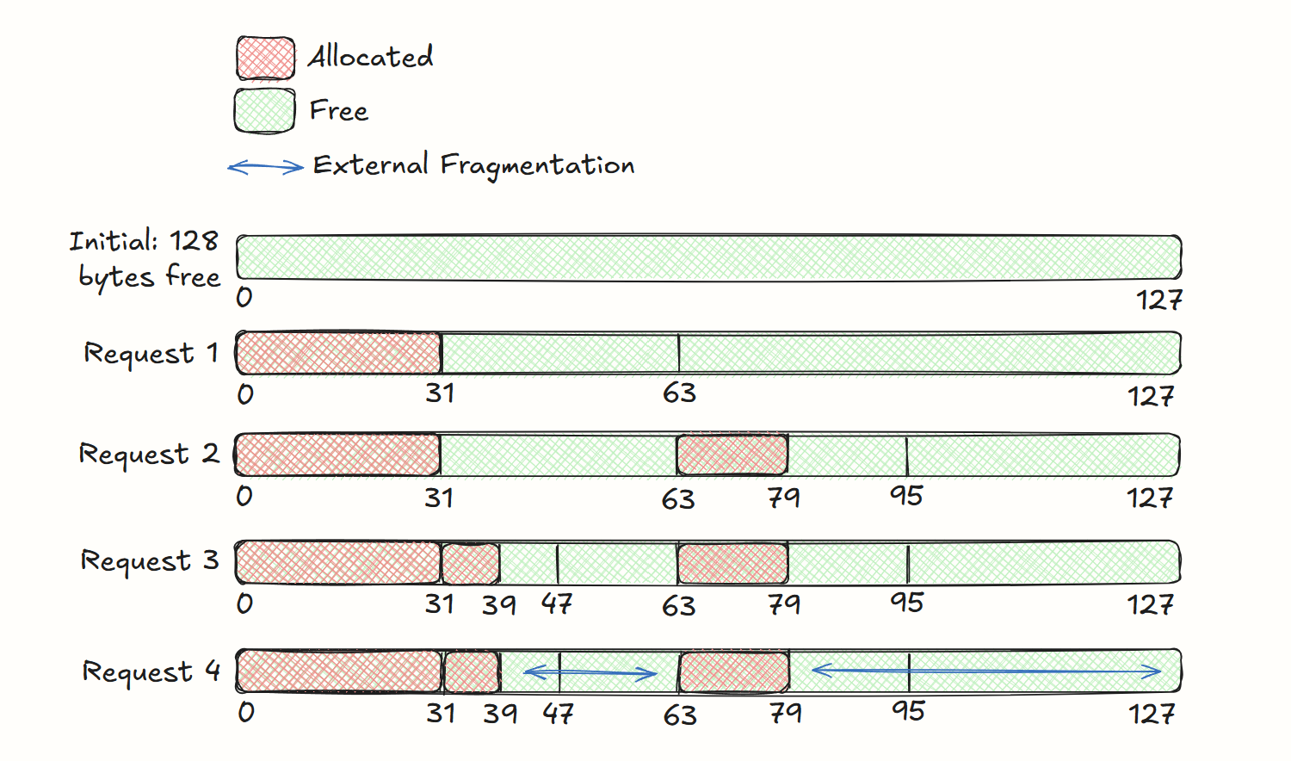
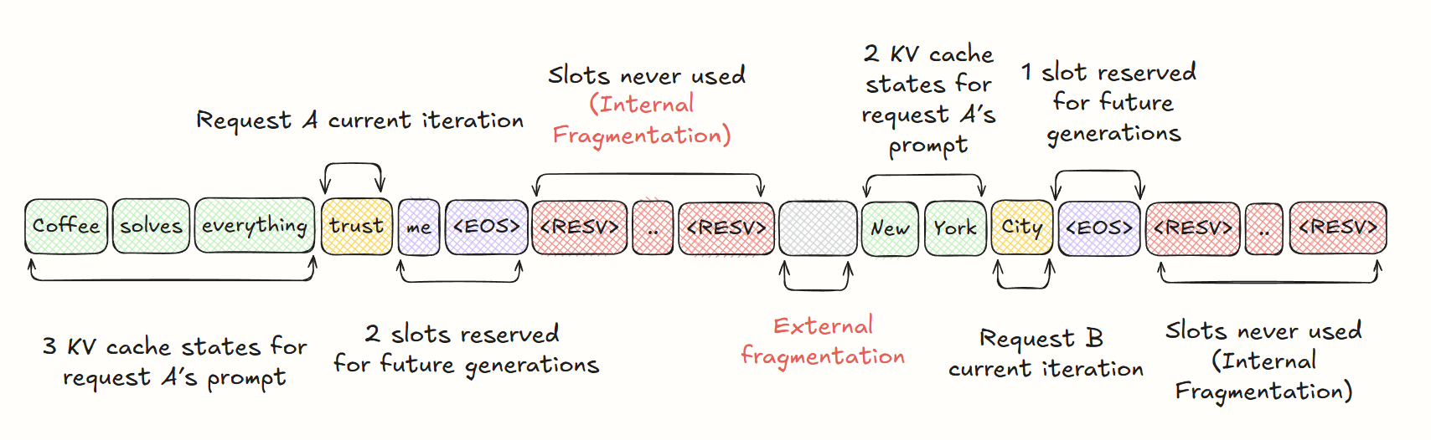
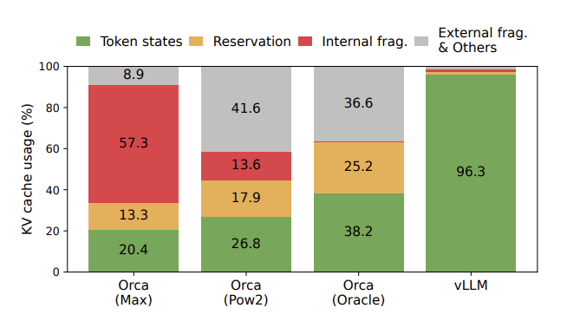
Existing systems waste 60–80% of KV memory
Reserved slots
Held for tokens not yet generated — idle until then, blocking other requests
Internal fragmentation
Never used: the request stops before its max length (e.g. 2048)
External fragmentation
Allocator gaps: 72 of 128 bytes free, yet no 64-byte hole (buddy allocator)
20.4-38.2% of KV memory holds token states (remaining is waste)
Reserved, internal and external waste · H. Elshafie, after Kwon et al.
05
Notes:
FasterTransformer and Orca store each request's KV cache as one contiguous chunk sized for the maximum possible length (e.g. 2048), because output length is unknown in advance. Three wastes: reserved slots (eventually used, but blocks others for the request's whole lifetime), internal fragmentation (never used because the request ended early), external fragmentation (allocator gaps). External example from Elshafie's blog: a 128-byte buddy-allocated pool serving 32-, 16- and 7-byte requests leaves 72 bytes free but no contiguous 64-byte block, so a 64-byte request fails. Table = paper Fig. 2 (share of KV memory; Used = token states, Resv. = reservation, Int./Ext. = internal/external fragmentation). Even Orca (Oracle), which knows every output length, uses only 38.2%. vLLM: 96.3%.

Slide 6
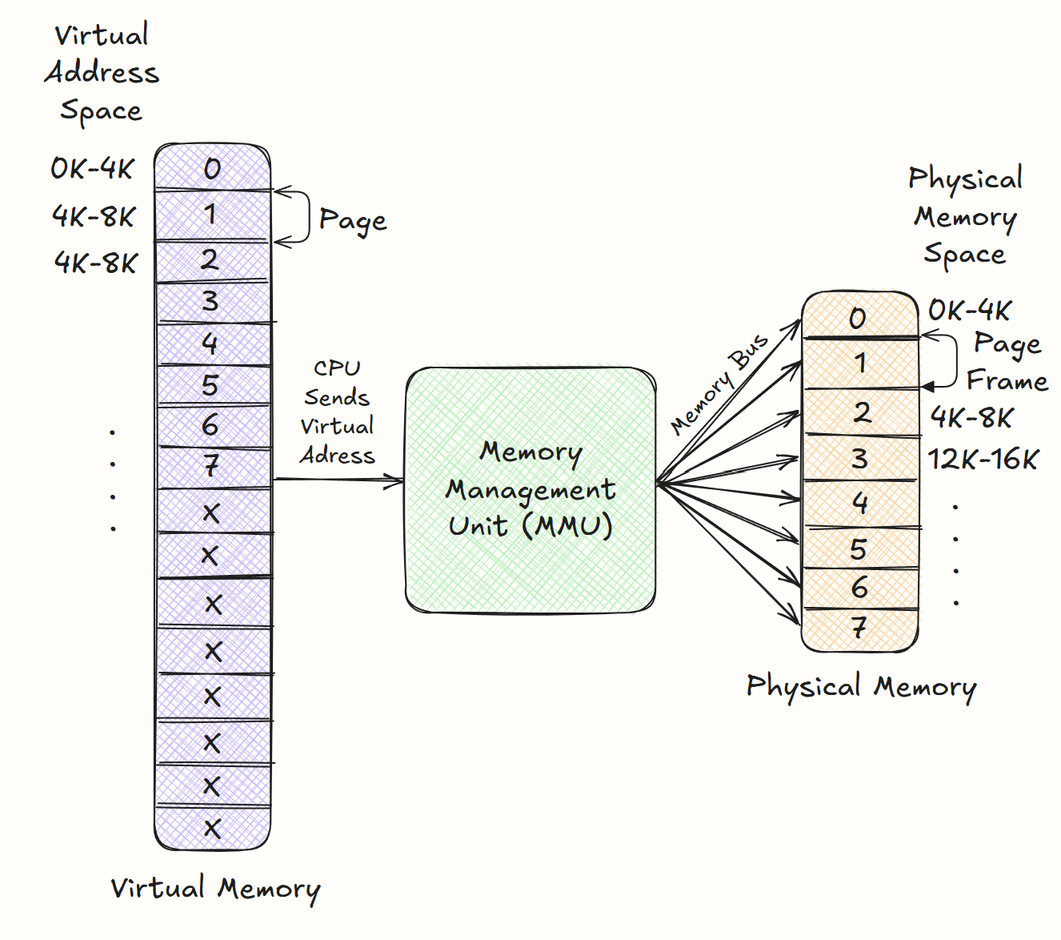
vLLM manages KV memory like an OS
OS concept | In vLLM
Page | Fixed-size KV block (16 tokens)
Page table | Block table: logical-to-physical block
Fork | New sequence shares its parent’s blocks
Copy-on-write | Copy a shared block only when it is written
Append | Fill the last block; add one when full
Free | Ref count hits 0: block returns to the pool
Scheduling | FCFS; a request’s beams run as one group
Preemption | Out of blocks: evict newest, all-or-nothing
Swap / recompute | Blocks to CPU RAM, or re-prefill later
OS paging: virtual pages mapped by the MMU to physical frames · H. Elshafie
blocks = pages · tokens = bytes · requests = processes
Buys: no reservation · no external fragmentation · shared prompts, samples and beams · progress under memory pressure. Recompute has no OS analogue.
06
Notes:
OS refresher (Elshafie's example): a 64 KB virtual address space in 4 KB pages maps onto 32 KB of physical memory in 4 KB frames; a page table records which virtual page sits in which frame, and an absent page triggers a page fault that the OS services. Programs see one large contiguous space. vLLM's mapping: blocks are pages, tokens are bytes, requests are processes. Every sharing pattern is built from three primitives - fork, append, free - and because the kernel only sees a list of physical block IDs per sequence, requests with different decoding methods can share one batch. Scheduling: memory grows on demand, so the GPU can run out of blocks mid-generation; vLLM uses FCFS and preempts the newest requests first. Eviction is all-or-nothing because a sequence cannot progress without all its blocks; beams are gang-scheduled as a sequence group. Swap uses a CPU block allocator (swap space never exceeds GPU KV space). Recompute treats prompt + generated tokens as a new prompt in one prefill pass - something an OS cannot do, since it cannot regenerate a page. Fig. 19: recompute overhead stays under ~20 ms while swapping small blocks exceeds 100 ms; comparable at block sizes 16-64. Desk/library analogy: desk = GPU, shelf = CPU RAM, hallway = PCIe. FLAG: while anything is swapped out, no new requests are admitted - this returns in the critique.

Slide 7
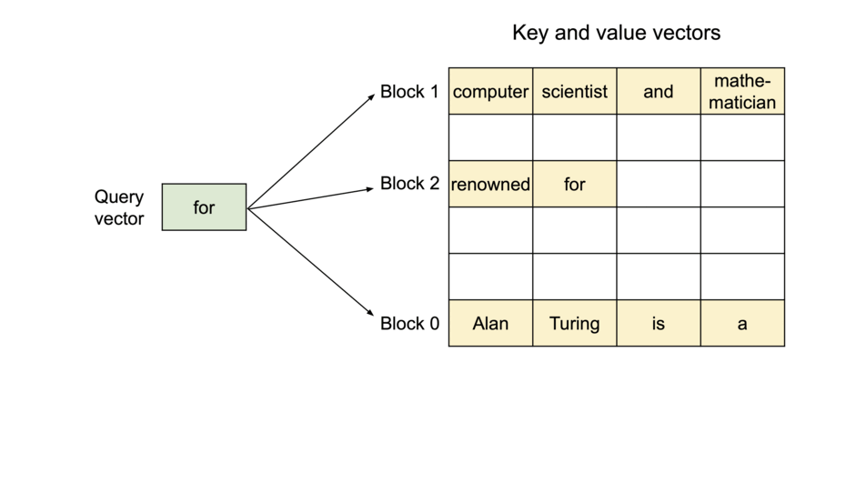
PagedAttention: store the KV cache in blocks
An attention algorithm that allows for storing continuous keys and values in non-contiguous memory space.
Fixed-size contiguous chunk anywhere in GPU memory, kept in order by a per-request block table.
16
tokens per block by default (B): the K and V for 16 tokens
≤ B − 1
empty slots per sequence: only its last block can be part-full
96.3%
of KV memory holds live tokens, vs 20.4–38.2% for Orca
The query attends to key/value blocks that are not contiguous in memory
Notes:
The core idea, in one slide. PagedAttention splits each sequence's KV cache into fixed-size KV blocks; each block holds the keys and values for B tokens (default B = 16). Blocks do not have to be next to each other in GPU memory. A block table per request maps logical blocks (the request's view, filled left to right) to physical blocks (wherever they happen to be). Tie back to the restaurant: parties sit at any free 4-seat tables, a new table is added only when more friends arrive, and the host keeps a seating chart - that chart is the block table. What it buys: memory is allocated on demand, so no reservation waste; every block is the same size, so no external fragmentation; the only waste is the unfilled tail of each request's last block, at most B-1 slots. Result in the paper (Fig. 2): 96.3% of KV memory holds token states vs 20.4-38.2% for the Orca variants. Walk through the GIF: logical view on the left, block table in the middle, physical blocks scattered on the right.

Slide 8
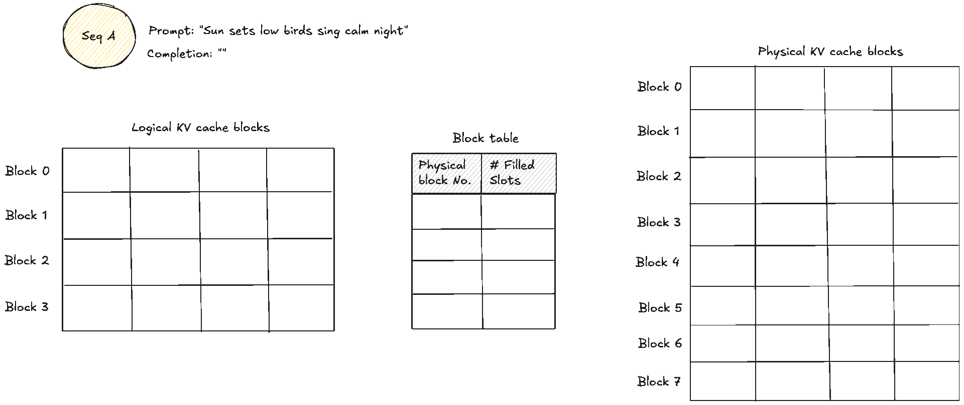
The attention kernel follows the block table
1 Look up
The block table says where logical block j lives in GPU memory
2 Score
Load keys Kⱼ and compute q · Kⱼ / √d for that block
3 Normalise
Keep a running max and sum across blocks (online softmax)
Logical blocks, block table and scattered physical blocks · H. Elshafie
Same maths as contiguous attention: only the memory access pattern changes
Cost: kernel 20–26% slower (lookups, branching); bigger batches still win end to end
4 Accumulate
Weight the values Vⱼ and add them into the output
One block table per layer and per head: each attention layer and head keeps its own mapping
Notes:
PagedAttention is the compute side that makes paged KV caching work. Classic attention assumes a sequence's keys and values sit in one contiguous buffer; PagedAttention drops that assumption. Picture (Elshafie): the query token 'soon' attends to past tokens stored in physical blocks 7 ('Sun sets low bid'), 1 ('sing calm night bring') and 3 ('peace soon'). The block table supplies the logical order. For query token i the kernel walks the ceil(i/B) blocks in logical order. For each block j it looks up the physical location, loads K_j, computes the partial scores q_i . K_j / sqrt(d), updates a running max and running sum (an online softmax, like FlashAttention), multiplies by V_j and accumulates into the output. The result is identical to standard attention. Footnote in the paper: each layer and head gets its own block tables. Implementation: three fused kernels - reshape + block write, block read + attention (one GPU warp per block for coalesced reads), and batched block copy for copy-on-write. The price, reported by the authors themselves: the kernel is 20-26% slower than FasterTransformer's attention kernel. It still wins end to end because the larger batch outweighs it. Keep this number in mind for the vAttention critique later.

Slide 9
The KV cache manager: logical blocks to physical blocks
No external fragmentation
All blocks are the same size, so any free block fits
1 Request → logical blocks
Each request’s KV cache is a list of logical blocks, filled left to right
2 GPU memory → physical blocks
The KV cache space on the GPU is cut into equal-sized physical blocks
3 Block table
Maps each logical block to a physical block and keeps its # filled slots
Internal: ≤ B − 1 tokens
Only the unfilled part of a sequence’s last block
4 Allocation on demand
A new physical block is taken only when the last block is full (# filled = B)
5 Free pool
When a request finishes, its blocks go back to the free pool for anyone
Fig. 6: block table translation · Kwon et al. 2023
Notes:
Walk the flow left to right on Fig. 6. (1) Each request's KV cache is represented as a series of logical KV blocks, filled from left to right as new tokens and their KV cache are generated. (2) The GPU memory reserved for KV cache is divided into physical KV blocks of the same size. (3) The block table maps each logical block to a physical block and records the number of filled positions in each block. Fig. 6 walkthrough (B = 4): the prompt 'Four score and seven years ago our' has 7 tokens, so it needs two logical blocks, mapped to physical blocks 7 and 1. Physical block 1 holds 3 tokens, so # filled = 3 and one slot is free. First decode step: 'fathers' goes into that free slot and # filled goes 3 -> 4. Second decode step: the last block is full, so only now is a new physical block (block 3) allocated for 'brought'. So memory is allocated on demand, one block at a time, which removes reservation waste. Because every block is the same size there is no external fragmentation: any free block can satisfy any request. Internal fragmentation is limited to the unfilled part of each sequence's last block, at most B-1 tokens. When a request finishes, its blocks return to the free pool and are reused immediately. Engine view (Elshafie's blog): the scheduler decides which requests run each step; the KV cache manager keeps the free block queue on the CPU and the real KV blocks live on the GPU. At start-up it measures the VRAM left after the weights, picks B and splits it into N blocks. Bytes per block per layer = 2 x KV heads x head dim x B x bytes per value.

Slide 10
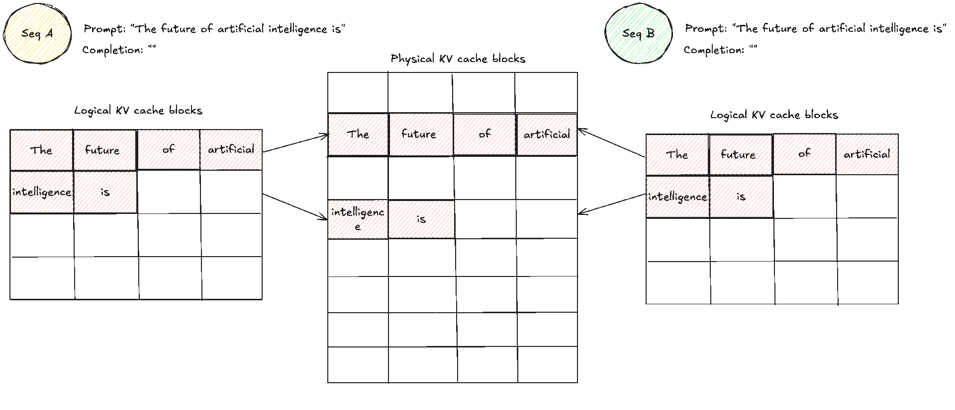
Sharing blocks: read-shared, write-unique
Reference count
Each physical block counts the logical blocks mapped to it, so shared KV is stored once.
Copy-on-write
Writing to a block with count > 1 copies just that block; the count drops 2 → 1.
Free
A finished sequence drops its counts; a block at 0 goes back to the free pool.
Two samples of one prompt share blocks until one of them writes · H. Elshafie
fork · append · free
three primitives build every sharing pattern
The kernel only sees block IDs, so requests with different decoding methods share one batch.
Notes:
Because the logical-to-physical mapping is explicit, several logical blocks can point at the same physical block. Each physical block carries a reference count. GIF (Elshafie): two sequences with the same prompt 'The future of artificial intelligence is'. Both block tables point at the same physical blocks. When Seq A writes 'likely' into the shared last block, the manager sees ref count > 1, copies that block, gives A the copy and drops the count 2 -> 1. When Seq B writes 'a subject', the count is already 1, so it writes in place. Block-level copy-on-write, same idea as fork(). Recipe-binder analogy: two cooks share the first pages of a binder with a tally on each page. Reading copies nothing. When Cook 1 writes on the last shared page they photocopy just that page; the tally drops 2 -> 1. Cook 2 then writes on the original. Rule: blocks are read-shared, write-unique - an unrelated request never writes into the spare slot of someone else's block. Numbers (Fig. 15, OPT-13B, Alpaca): parallel sampling saves 6.09-9.79% memory.

Slide 11

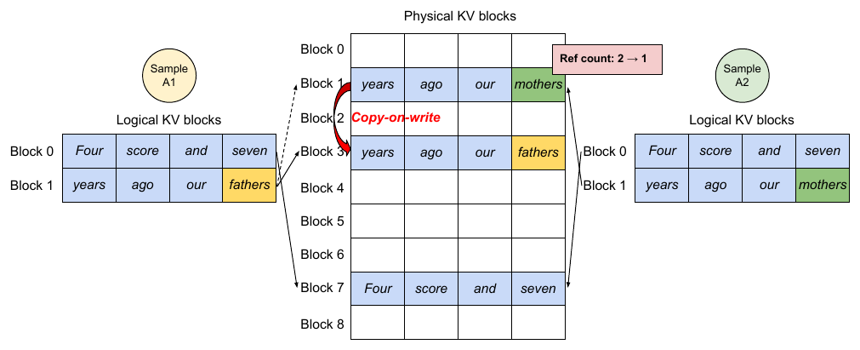
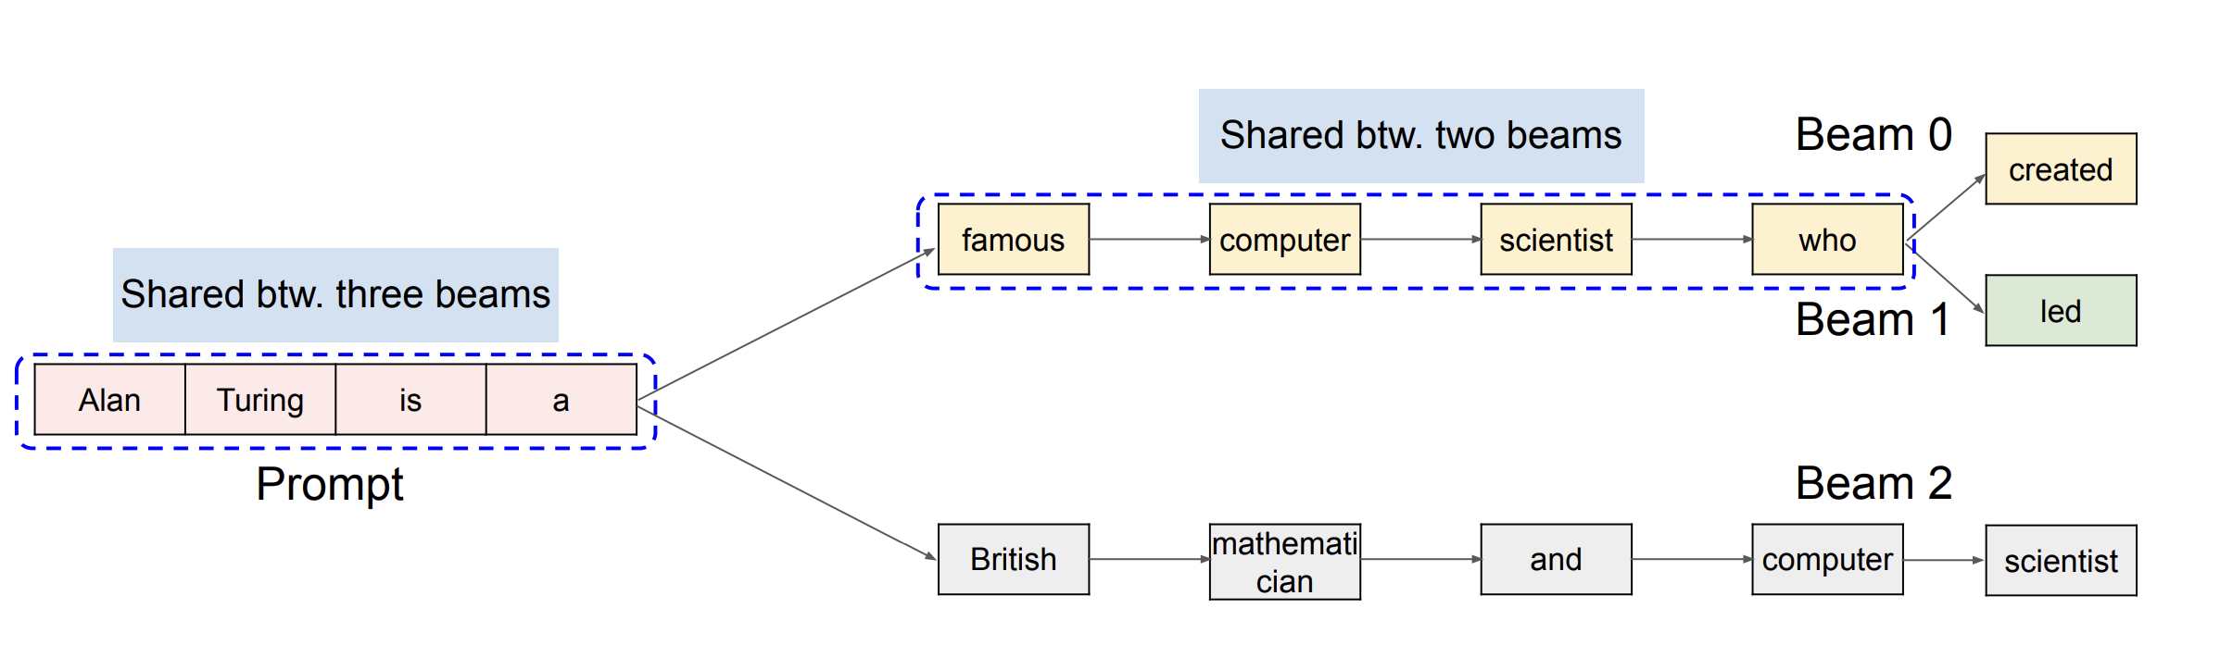
Parallel sampling and beam search
Parallel sampling
Beam search
saves 6.1–9.8% memory
saves 37.6–55.2% memory
Fig. 8: two samples, one prompt · Kwon et al. 2023
Three beams share the prompt; two share a longer prefix · Kwon et al., 2023
One prompt, several outputs (e.g. candidate code completions to pick from)
Both samples map the prompt to the same physical blocks (ref count 2)
A1 writes into shared block 1 → it is copied to block 3, count 2 → 1; A2 then writes in place
Keeps the top k candidates each step; they share prefixes like a process tree
Candidates that drop out lower their blocks’ counts; blocks at 0 are freed
Older systems copied whole KV caches on every re-rank; vLLM copies at most one block
Throughput over Orca Oracle: 1.3× with basic sampling, rising to 2.3× with beam width 6 (OPT-13B, Alpaca)
Notes:
Two decoding methods where one request produces several sequences that overlap. Parallel sampling (Fig. 8): one prompt, several sampled outputs - e.g. a code assistant offering several completions. The prompt's KV cache is identical for every sample, so vLLM stores it once: both samples' logical blocks for the prompt map to the same physical blocks, and each physical block's reference count is 2. When sample A1 writes its first new token into the last logical block, the manager sees the physical block (block 1) has ref count > 1, allocates block 3, copies the contents, maps A1's logical block to it and drops block 1's count from 2 to 1. When A2 writes, block 1's count is already 1, so it writes in place. Copy-on-write at block granularity. Saves 6.09-9.79% memory (Fig. 15, OPT-13B, Alpaca). Beam search (width.ai explains the idea): instead of greedily taking the single best token, keep the top-k partial sequences (beam width k) each step, extend each, and prune back to k. The picture: all three beams share the prompt 'Alan Turing is a'; beams 0 and 1 also share 'famous computer scientist who'. In vLLM those shared prefixes are shared physical blocks. When a candidate drops out of the top k its logical blocks are freed and the reference counts fall; blocks reaching 0 go back to the pool (paper Fig. 9 frees blocks 2, 4, 5, 8 and allocates 9-12). Earlier systems physically copied large parts of the KV cache on every re-rank; vLLM copies at most one block. Saves 37.56-55.16% memory. Throughput gain over Orca (Oracle) on OPT-13B/Alpaca grows from 1.3x for basic sampling to 2.3x for beam search with width 6, because more sharing means more saved memory.

Slide 12
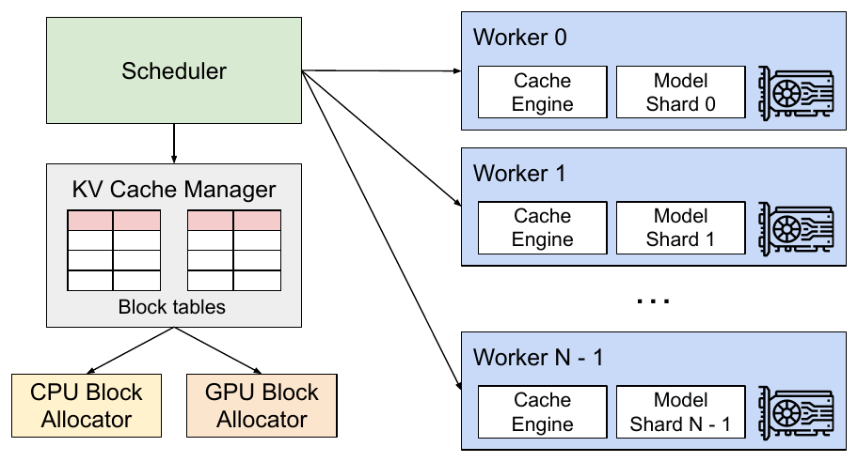
Scheduling, preemption and distributed execution
When the GPU runs out of free blocks
Distributed execution
First come, first served: the newest requests are preempted first
All or nothing: a sequence needs all its blocks to make progress
A request’s beams are scheduled together as one group
Swap blocks move to CPU RAM
A CPU block allocator holds evicted blocks; swap space ≤ GPU KV space
Slow with small blocks: many tiny PCIe transfers
While anything is swapped out, no new requests are admitted
Fig. 4: vLLM system overview · Kwon et al. 2023
Recompute drop blocks, rebuild later
Megatron-LM style tensor parallelism: attention is split across heads, each GPU runs a subset
One KV cache manager in the central scheduler; every GPU uses the same block IDs but stores only its heads’ KV
Each step the scheduler broadcasts token IDs + block tables; GPUs all-reduce among themselves, no memory sync
Prompt + generated tokens run again as one prefill pass
Cost flat across block sizes; on par with swap at B = 16–64
No OS analogue: an OS cannot regenerate a page
Notes:
Because memory grows on demand, the GPU can run out of free blocks mid-generation. vLLM uses first-come-first-served ordering and preempts the newest requests first. Eviction is all-or-nothing per sequence, because a sequence cannot progress without all of its blocks. Sequences that share memory - e.g. the beams of one request - are gang-scheduled as a sequence group. Two ways to recover. Swapping: copy the blocks to CPU RAM through a CPU block allocator; swap space never needs to exceed the GPU's KV space. FLAG for later: while anything is swapped out, vLLM stops admitting new requests - this comes back in the critique. Recomputation: throw the blocks away and rebuild later by treating prompt + generated tokens as a new prompt, recomputed in one prefill pass - much cheaper than the original step-by-step generation. An OS cannot do this: it cannot regenerate a page's contents. Ablation (Fig. 19): swapping is poor with small blocks (many tiny PCIe transfers); recomputation cost does not depend on block size; the two are comparable at block sizes 16-64. Desk/library analogy: desk = GPU memory, shelf across the room = CPU RAM, hallway = PCIe. Carry notes to the shelf and back (swap) or throw them away and rewrite them from the textbook (recompute). With many small index cards you spend all your time walking, so rewriting wins.
DISTRIBUTED EXECUTION (Section 4.6, Fig. 4): many LLMs do not fit on one GPU, so vLLM supports Megatron-LM style tensor model parallelism, an SPMD schedule: linear layers are partitioned for block-wise matrix multiplication and GPUs synchronise intermediate results with all-reduce. The attention operator is split on the attention-head dimension, so each SPMD process handles a subset of the heads. Every model shard still processes the same input tokens and needs KV cache for the same positions, so vLLM keeps a single KV cache manager inside the centralized scheduler. All GPU workers share the same logical-to-physical mapping and the same physical block IDs, but each worker stores only the KV cache for its own attention heads. Each step: the scheduler prepares a message with the input token IDs and the block table of every request in the batch and broadcasts it; workers run the model, read KV cache according to the block tables, all-reduce among themselves without the scheduler, and send the sampled tokens back. Workers never need to synchronize on memory management.

Slide 13
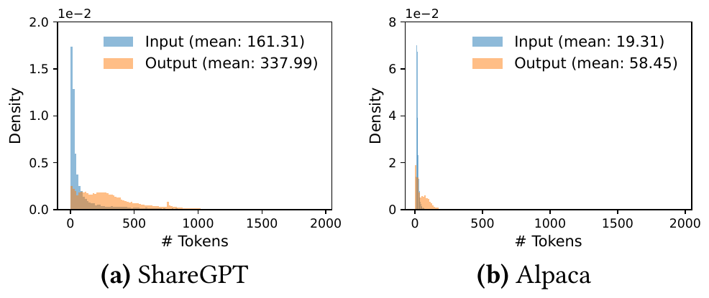
What vLLM was compared against
Baseline 1 · FasterTransformer (NVIDIA)
Authors built: its scheduler
Models | OPT-13B, 66B, 175B · LLaMA-13B
GPUs | A100s on Google Cloud: 1, 4 or 8
Workloads | ShareGPT and Alpaca lengths, Poisson arrivals
Metric | Normalized latency (mean s/token) vs request rate
An inference engine tuned for latency, with no scheduler of its own
The authors wrote one: dynamic batching like Triton’s, taking up to B of the earliest requests
B set as large as GPU memory allows in each experiment
So the “up to 22×” result compares schedulers, not memory managers
Baseline 2 · Orca (OSDI ’22)
Authors built: Orca + allocator
Not publicly available, so the authors reimplemented it themselves
KV cache placed with an assumed buddy allocator (Orca’s paper names none)
Max: always reserves 2,048 tokens (weakest, most dramatic bars)
Pow2: over-reserves up to 2× (true length 25 → 32 slots)
Oracle: knows the true output length, impossible in practice
Fig. 11: ShareGPT prompts are 8.4× and outputs 5.8× longer than Alpaca’s · Kwon et al.
One shared codebase, but neither baseline was ever released
13
Notes:
Before the results, say what vLLM was compared against, because two of the baselines contain code the authors wrote themselves. Baseline 1, FasterTransformer: NVIDIA's distributed inference engine, highly optimized for latency. It has no scheduler of its own, so the authors implemented a custom scheduler with dynamic batching similar to Triton: set a maximum batch size B as large as GPU memory allows, take up to B of the earliest-arrived requests, and send that batch to FasterTransformer. Consequence: the headline 'up to 22x over FasterTransformer' mostly compares continuous (iteration-level) batching with this static-style batching, not paging. Baseline 2, Orca (OSDI '22): the state-of-the-art throughput-oriented serving system, but not publicly available, so the authors built their own version. They assume Orca places KV cache with a buddy allocator (Orca's paper does not specify one). Three variants by how much output space is reserved: Max always reserves the model's maximum of 2048 tokens; Pow2 over-reserves by at most 2x (true length 25 -> 32 slots); Oracle knows the true output length - an unachievable upper bound. Setup (Section 6.1, Table 1): OPT-13B on 1 A100-40GB, OPT-66B on 4 A100s, OPT-175B on 8 A100-80GB, plus LLaMA-13B; Google Cloud A2 instances. Workloads synthesized from ShareGPT (mean 161 input / 338 output tokens) and Alpaca (19 / 58); no timestamps, so Poisson arrivals at different request rates; 1-hour traces (15 minutes for OPT-175B). Metric: normalized latency = the mean over requests of end-to-end latency divided by output length; throughput is read off as the request rate where normalized latency explodes. All systems share one codebase (the audit credits this), but the baseline implementations were never released. Note for the critique: Agrawal et al. report the baselines ran with a fixed batch size of 8 in the artifact - check this against the paper's statement that FT's B was set as large as memory allowed.

Slide 14
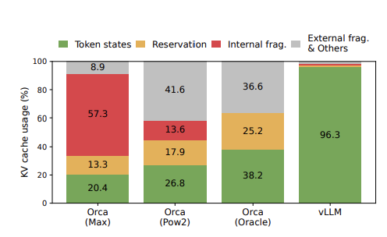
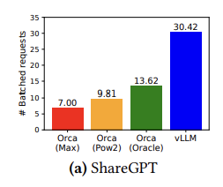
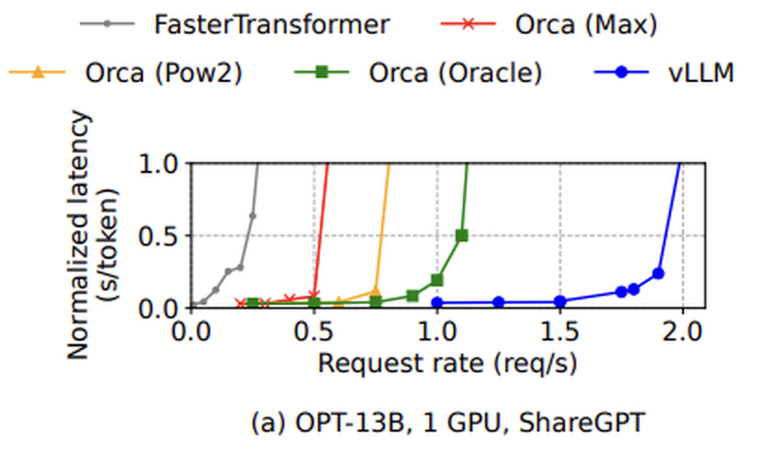
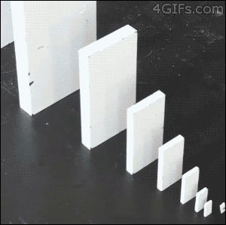
Does it work? Three results, one chain
The argument: less wasted memory → bigger batches → more requests per second. Each figure checks one step.
1 Less memory wasted?
2 So more requests fit?
3 So more throughput?
96.3% vs 20–38%
30.4 vs 13.6
1.7–2.7×
of KV memory holds tokens (vLLM vs Orca)
avg. requests per batch, vLLM vs Oracle
request rate vs Orca Oracle, same latency
→
→
Fig. 2 · green = memory holding tokens
Fig. 13(a) · taller bar = bigger batch
Fig. 12(a) · curve rises later = more requests/s
Built on three custom CUDA kernels
Fused reshape + block write: new K, V go straight into their blocks
Fused block read + attention: one GPU warp per block, variable lengths
Fused block copy: batches copy-on-write copies into one launch
14
Notes:
Precise claim: for online serving, the binding constraint is not compute but the fraction of GPU memory holding live KV token states; block-based, non-contiguous KV with a logical->physical indirection raises that fraction to ~100%, which raises batch size, which raises throughput 2-4x at equal latency, without changing outputs. Break any link and the result breaks. Why Fig. 13 is the best evidence: it measures the middle link - the mechanism - not just the outcome. Fig. 12 conflates memory management with everything else (especially vs FT); Fig. 2 is measured on the authors' own reimplementation. Fig. 16 (shared prefix) is the cleanest isolated demo of sharing. Fig. 12(f), OPT-175B on Alpaca: gain largely disappears when memory is plentiful and sequences short - arguably the most informative panel. Setup: OPT-13B/66B/175B + LLaMA-13B on A100s; ShareGPT (~161 in / ~338 out) and Alpaca (~19 / ~58); Poisson arrivals. Metric: normalized latency (s/token) vs request rate. Sharper reading for the room: the paper implicitly claims the application layer is the right place to fix fragmentation - that is what later work disputes. Images: Fig. 12 is cropped to panel (a), OPT-13B on ShareGPT - the same setting as Fig. 13(a), so the three panels describe one experiment. Panel (f), OPT-175B on Alpaca, is the negative result if asked.
HOW TO READ THIS SLIDE: the paper's claim is a chain of three links, and each figure tests one link. (1) Fig. 2: is less KV memory wasted? The green part of each bar is memory actually holding token states: 96.3% for vLLM vs 20.4-38.2% for the Orca variants. (2) Fig. 13(a): does that let more requests run at once? Average batched requests on ShareGPT: 30.42 vLLM vs 13.62 Orca Oracle vs 7.00 Orca Max. (3) Fig. 12(a): does that raise throughput? Each curve is latency vs request rate; the further right a curve stays flat before shooting up, the more requests per second the system sustains. vLLM sustains 1.7-2.7x the rate of Orca Oracle, 2.7-8x Orca Max, up to 22x FasterTransformer. KERNELS (Section 5.1): PagedAttention's access pattern is not supported efficiently by existing kernels, so vLLM adds three: (1) fused reshape and block write - new KV cache is split into blocks, reshaped for block reads and saved at the positions given by the block table, in one kernel; (2) fused block read and attention - adapted from FasterTransformer's attention kernel, reads KV by block table on the fly, one GPU warp per block for coalesced access, and supports variable sequence lengths in a batch; (3) fused block copy - batches the many small copy-on-write copies into one kernel launch instead of many cudaMemcpyAsync calls.

Slide 15

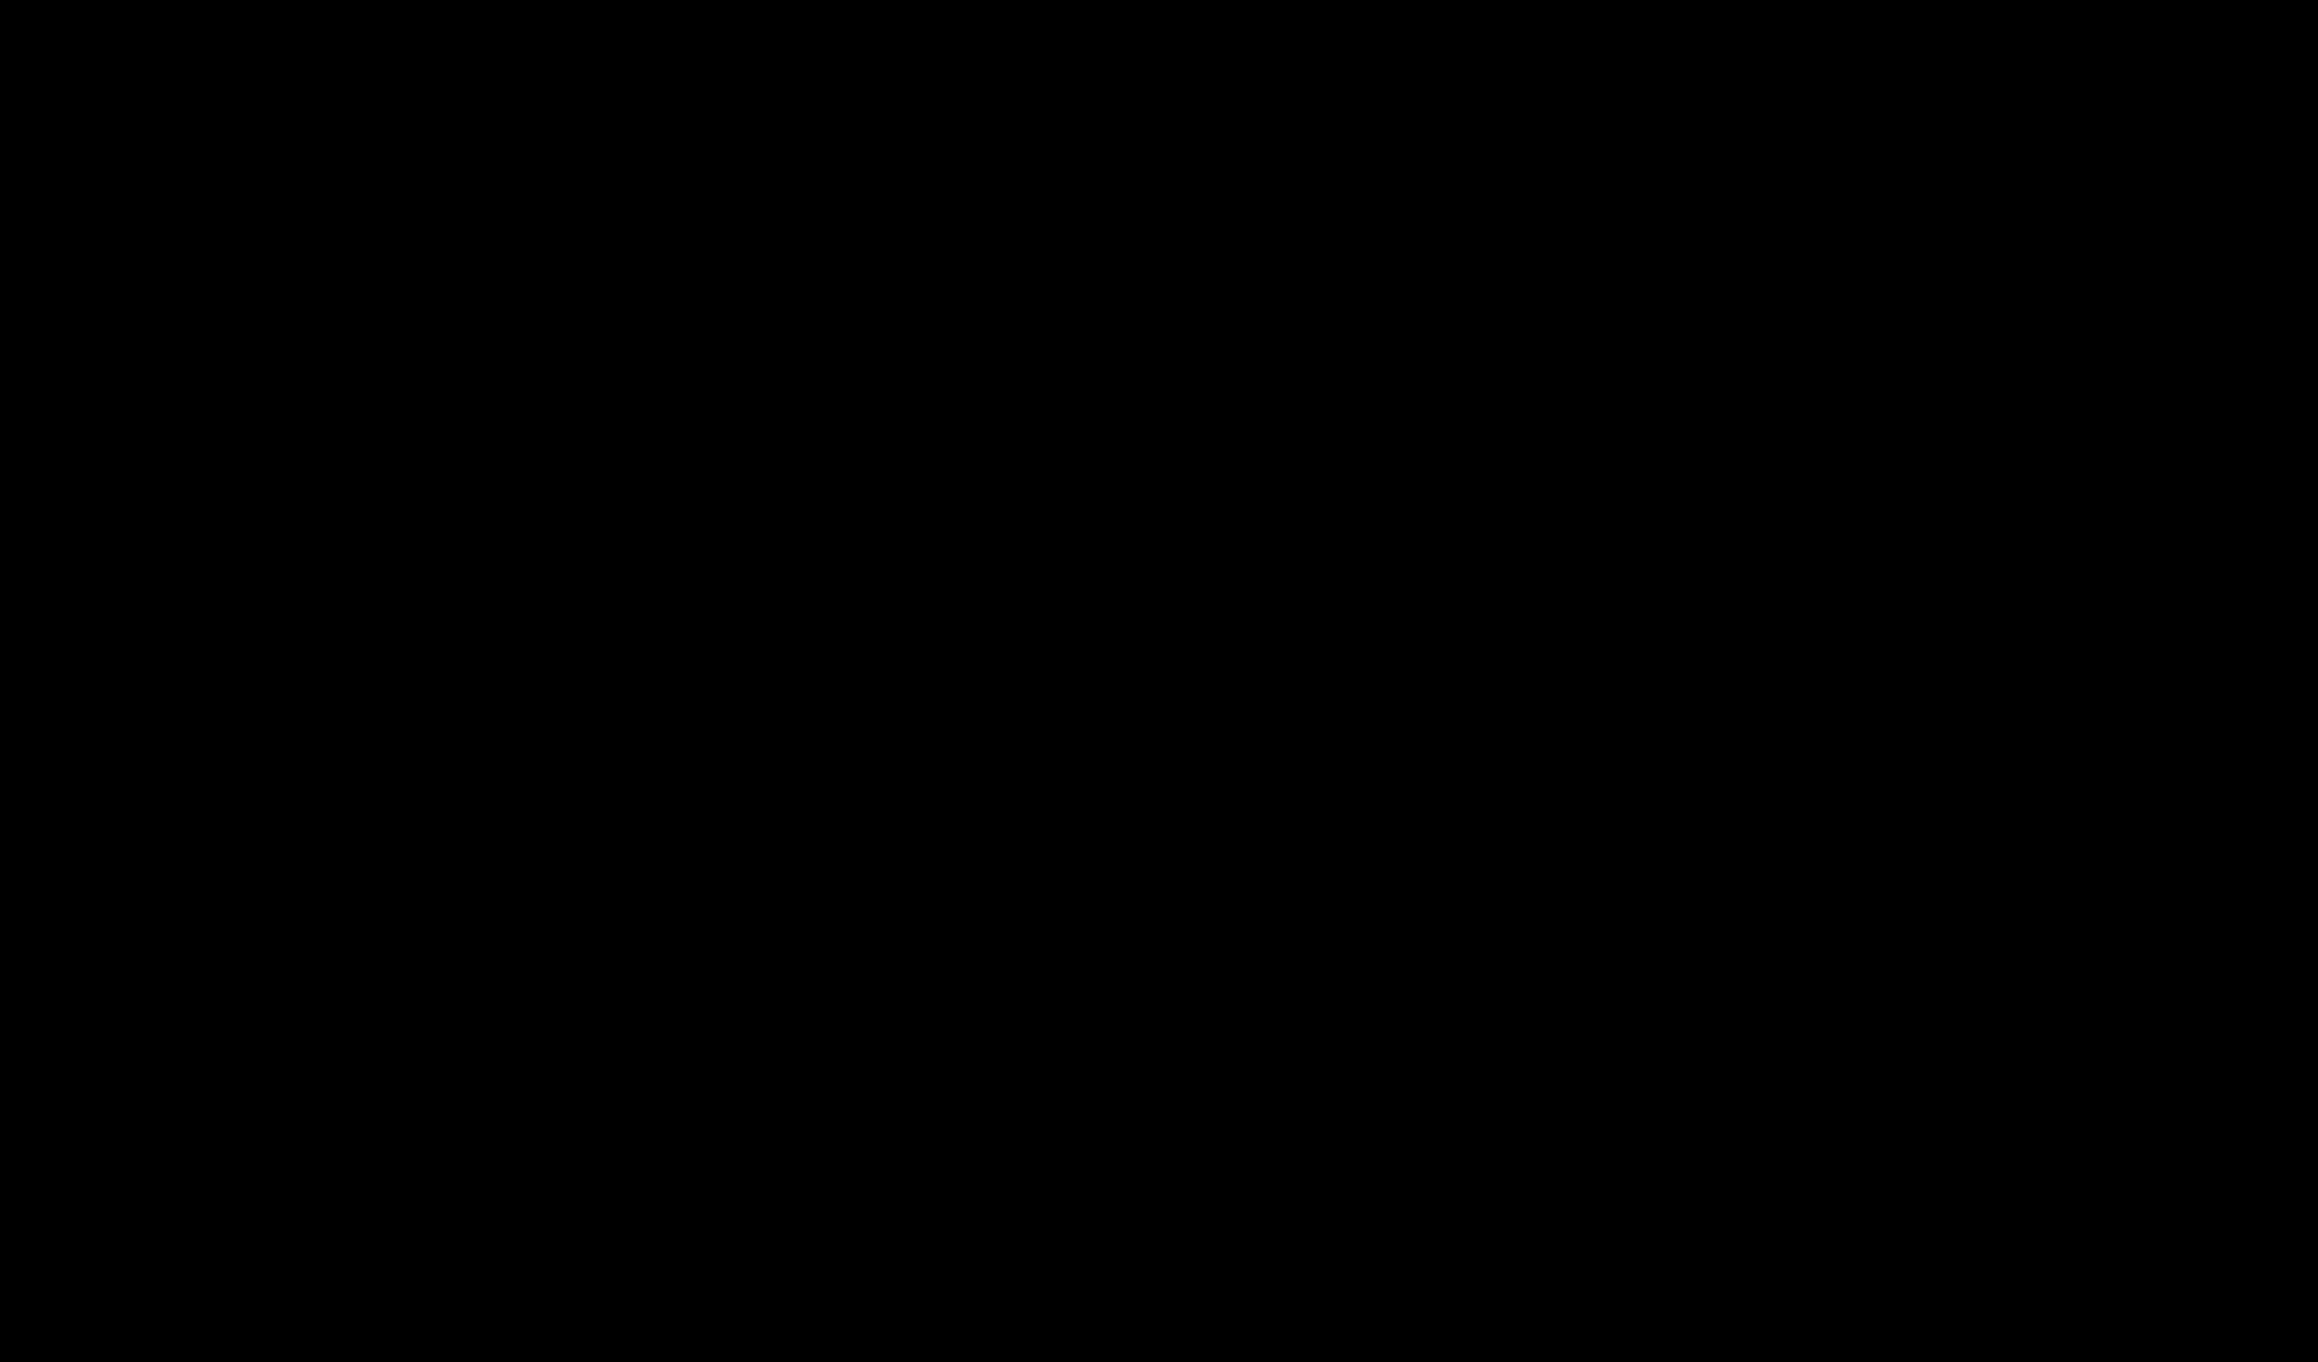
Demo
Live Demo:
https://aaroncherian404.github.io/vllm-pagedattention-demo/
15
Notes:
Live demo.

Slide 16
What the paper gets right
The framing is the contribution
The abstraction held
Only 20–38% of KV memory held live tokens: serving became a memory-management problem
Block table + ref counts + CoW became the de facto standard (TensorRT-LLM, HF TGI, LightLLM)
It reports its own losses
Its scope is disciplined
Attention kernel 20–26% slower; gain nearly vanishes on OPT-175B / Alpaca
Says paging would hurt training & compute-bound models; complementary to Orca
Are the baselines fair?
In their favour
Even Orca (Oracle), which knows output lengths, loses by 1.7–2.7×
A buddy allocator for Orca is a natural choice, not a strawman
Against them
Orca (Max), the weakest setting, feeds the “2–4×” headline
Baselines never released: they are not in vLLM’s git history
16
Notes:
Say this first - it earns the right to criticize. The reframing (kernel-optimization problem -> memory-management problem) is worth more than the mechanism. Even critics (vAttention) acknowledge the block abstraction became the de facto standard. Honest reporting: the kernel slowdown and the OPT-175B/Alpaca near-zero gain are both in the paper. Scope: paging helps only when allocation is dynamic AND performance is memory-capacity bound; training (static shapes) and compute-bound non-LLM serving would likely slow down. Framed as complementary to Orca: Orca's fine-grained scheduling makes memory management harder, which vLLM solves.
BASELINE FAIRNESS (moved from the old 'Budget-matched' slide): Budget-matched is not in dispute: same GPUs, models, traces, arrival process, memory. Give credit for Oracle BEFORE landing the criticism: nobody rigging a comparison includes an unachievable upper bound they still must clear, and the buddy allocator is a reasonable assumption since Orca's paper does not name one. Against: Orca (Max) always reserves 2048 tokens - batch 7.0 vs 30.4 - the least defensible baseline, yet it produces the most dramatic bars and the abstract's 2-4x quietly blends it in. Reproducibility: I searched the full git history of vllm-project/vllm - the baseline implementations are not there (the only 'Orca' hits are an unrelated 2025 ORCA load-metrics feature); public benchmarks drive only vLLM and TGI. The other two fairness points - the 22x over FasterTransformer measuring the authors' own scheduler, and untuned baselines on a shared codebase - are raised by Agrawal et al. and sit on the Critique 5 slide.

Slide 17
Six assumptions, six follow-up papers
Open Source: Updates to every aspect of vLLM
1 · The layer
2 · The scheduler
3 · Colocation
Dynamic allocation needs a non-contiguous virtual layout
Prefill and decode steps are interchangeable
Prefill and decode belong on the same GPUs
Fixed by vAttention · vTensor
Fixed by Sarathi-Serve
Fixed by DistServe · Splitwise · Mooncake
4 · Sharing policy
5 · The evaluation
6 · Cost and size
Bent
The provider knows and declares what to share
Averaged normalized latency is an adequate metric
CPU scheduling is free; the KV cache always dominates
Fixed by SGLang (SPOILERS!)
Fixed by Agrawal et al. 2025
Fixed by Srivatsa et al. · GQA / MQA
Everyone agrees KV memory management sets serving throughput.
17
Notes:
Roadmap for the critique. The framing: this is what a foundational paper looks like when it is being built on rather than overturned. Every paper here accepts the diagnosis - that KV-cache memory management determines serving throughput. What they dispute is the layer where paging happens, the scheduler, where prefill and decode run, who decides what gets shared, how it was measured, and the cost model and problem size. Go through the six in order; each gets one slide with the same structure: what vLLM assumed, the critique, the critic's numbers, the evidence in vLLM's own code where there is any, what happened since, and a verdict. Epilogue to hold for the end: vLLM itself absorbed several of these critiques - chunked prefill, hash-based automatic prefix caching, disaggregated prefill - all on top of the same block abstraction. The abstraction held; the surrounding assumptions did not.

Slide 18
Critiques 1 & 2: the memory layer and the scheduler
1 · THE LAYER
2 · THE SCHEDULER
vAttention & vTensor
Sarathi-Serve (OSDI ’24)
vLLM assumed: allocating physical memory on demand requires a non-contiguous virtual layout.
vLLM assumed: a prefill step and a decode step are interchangeable units of scheduling (inherited from Orca).
The critique
The critique
Fragmentation is a physical-memory problem, and GPUs already provide virtual memory (CUDA VMM APIs)
vAttention keeps each request contiguous in virtual memory and maps physical pages as it grows
Stock kernels (FlashAttention, FlashInfer) then run unchanged; paging needs each one rewritten
vTensor (SJTU + Ant Group) reached the same conclusion independently
vLLM runs a batch of prefills on its own, so every running decode waits: a generation stall
Stalls show up as inter-token latency spikes, which the paper’s metric does not report
Chunked prefills split a long prompt into near-equal pieces
Stall-free batching adds those pieces to batches that keep decoding
Two translation layers: vLLM’s block tables sit on top of the GPU’s own page tables.
Since then: FlashAttention-3 and cuDNN-9 attention shipped without PagedAttention support.
In vLLM’s code (Oct 2023): _schedule() returns prompt_run=True, so prefill batches run alone; scheduling is hardcoded FCFS.
Since then: vLLM adopted chunked prefill; its V1 engine mixes prefill and decode in one step.
18
Notes:
Lead the critical-analysis section's conceptual point with this. An OS pages because it has no choice; a GPU serving system has a virtual-memory layer available underneath it. The paper never considers that alternative, and the omission costs every downstream kernel author real work. vAttention charges: software complexity, portability, redundancy, runtime overhead; PagedAttention adds two layers of address translation (framework block tables on top of GPU page tables). FlashAttention-3 and cuDNN-9 SDPA shipped without PagedAttention support. The paper's own 20-26% kernel overhead was measured against a 2023 kernel and understates an ongoing tax. vAttention prompt processing up to 3.92x / 1.45x faster than paged FlashAttention / FlashInfer. vTensor (SJTU + Ant Group, arXiv:2407.15309): page management and kernels tightly coupled; decouple via GPU VMM; avg 1.86x, up to 2.42x multi-turn. Two independent groups converged on the same criticism. Also: block size 1.9x swing undercuts the paper's 'block size 16' ablation. Source: vAttention arXiv:2405.04437. Diagram (schematic): in vLLM the kernel indexes a pool of blocks and must chase the block table to find A1, A2, A3; in vAttention the sequence is contiguous in virtual memory and the GPU's own page tables (CUDA VMM) back it with physical pages on demand, so stock kernels like FlashAttention run unchanged. ASPLOS '25 abstract: vAttention supports various attention kernels out of the box and improves serving throughput by up to 1.23x over the PagedAttention-based kernels of FlashAttention and FlashInfer. vTensor abstract: average 1.86x speedup, up to 2.42x in multi-turn chat. (The 1.97x decode figure in the older slide came from an earlier arXiv version of vAttention; the 1.23x is from the published version.)
Sarathi-Serve (Agrawal et al., OSDI '24; an optional reading this week). The assumption, inherited unexamined from Orca: a prefill iteration and a decode iteration are interchangeable units for the scheduler. They are not: prefill is long and compute-bound, decode is short and memory-bound. vLLM's scheduler (commit ebe4d1db3, Oct 2023): _schedule builds a prompt-only batch and returns immediately with prompt_run=True. While that prefill batch runs, every ongoing decode waits - a generation stall - which shows up as an inter-token-latency spike for users, and is invisible under the paper's normalized-latency metric. Scheduling is also hardcoded FCFS (PolicyFactory.get_policy(policy_name='fcfs')), so the flexibility paging creates is never used by a smarter policy. Sarathi-Serve's fix: chunked prefills split a prompt into near-equal chunks; stall-free scheduling adds those chunks to batches that keep decoding, so new requests join without pausing ongoing decodes; uniform batches also reduce pipeline bubbles. Results (abstract): 2.6x higher serving capacity for Mistral-7B on one A100, up to 3.7x for Yi-34B on two A100s, and up to 5.6x end-to-end for Falcon-180B with pipeline parallelism, all vs vLLM under tail-latency constraints. Since then: vLLM supports chunked prefill, and the V1 engine's scheduler can mix prefill and decode in the same step (Elshafie's blog notes V0 could only do one at a time).

Slide 19
Critiques 3 & 4: where requests run and what they share
3 · COLOCATION
4 · SHARING POLICY
DistServe · Splitwise · Mooncake
SGLang (NeurIPS ’24,)
vLLM assumed: prefill and decode share the same GPUs, run by one central KV cache manager on one node.
vLLM assumed: sharing patterns are known to the provider and declared ahead of time as fixed prefixes.
The critique
Spoilers!
The critique
Prefill is compute-bound and decode is memory-bound; on one GPU they interfere and can’t be tuned apart
Give each phase its own GPUs or machines, sized for its own latency target, and ship the KV cache between them
Mooncake (Kimi’s platform) centres the cluster on the KV cache, spilling it to CPU DRAM and SSD
Agents, few-shot prompts, RAG pipelines and multi-turn chat share prefixes nobody declares
RadixAttention keeps KV cache in a radix tree over tokens; each request reuses its longest cached prefix
Cached KV outlives the request (LRU eviction), so the next turn or call reuses it
Why it matters: vLLM becomes one component inside a larger architecture; paging still runs inside each worker.
Since then: vLLM added experimental disaggregated prefill.
In vLLM’s code (Oct 2023): the block allocator is a free list + ref counts with no content hashing; the benchmark keeps 2 turns per chat.
Since then: vLLM added hash-based automatic prefix caching on the same block tables.
19
Notes:
DistServe (Zhong et al., OSDI '24), Splitwise (Patel et al., ISCA '24), Mooncake (Qin et al., FAST '25). Shared argument: prefill is compute-intensive and decode is memory-intensive, with different latency, throughput, memory and power profiles. Colocating them on the same GPUs causes prefill-decode interference and couples their resource allocation and parallelism. DistServe assigns prefill and decoding to different GPUs, tunes each for its latency target (TTFT for prefill, time per output token for decode) and places them according to cluster bandwidth: 7.4x more requests or 12.6x tighter SLO while meeting latency limits for over 90% of requests. Splitwise splits the phases onto separate machines connected by fast backplane interconnects: 1.4x higher throughput at 20% lower cost, or 2.35x throughput at the same cost and power. Mooncake (the serving platform for Moonshot AI's Kimi) is KVCache-centric: separate prefill and decode clusters plus a disaggregated KV cache in the cluster's CPU DRAM and SSD, with a KVCache-aware scheduler and early rejection under overload; up to 525% more throughput in simulated long-context scenarios and 75% more requests under real workloads. What this does to vLLM: its design - one centralized scheduler, one KV cache manager, all workers on one node running both phases (Fig. 4) - becomes one node type inside a larger architecture. Block-level paging still happens inside each worker; what breaks is the assumption about placement. Since then, vLLM has added experimental disaggregated prefill.
SGLang (Zheng et al., NeurIPS '24) - our paired paper. vLLM shares KV blocks within a request (parallel samples, beams) and for prefixes the service provider reserves in advance (Fig. 10). It cannot find shared prefixes across arbitrary requests: the block allocator is a plain Python free list with per-block reference counts and no content hashing, and the evaluation keeps only the first two turns of each ShareGPT conversation while the chatbot experiment discards KV between turns - so the workload where cross-request reuse matters most was never tested. RadixAttention stores cached KV in a radix tree keyed by token sequences. A new request matches its longest cached prefix automatically and only computes the rest; the cache is kept after requests finish and evicted with LRU. This targets LLM programs - agents, multi-call reasoning, few-shot learning, JSON decoding, RAG, multi-turn chat - where prefixes are shared but never declared. SGLang reports up to 6.4x higher throughput than state-of-the-art systems. Since then: vLLM added automatic prefix caching by hashing block contents (Elshafie's diagram shows a block_hash field in each block table entry), absorbing the critique into the same block abstraction. vLLM built the mechanism; SGLang supplied the policy.

Slide 20
Critiques 5 & 6: the evaluation and the cost model
5 · THE EVALUATION
6 · COST AND SIZE
Agrawal et al. (2025)
Srivatsa et al. (WukLab ’24) · GQA / MQA
vLLM assumed: normalized latency (end-to-end ÷ output tokens, averaged over requests) is an adequate serving metric.
vLLM assumed: per-step CPU scheduling is free, and the KV cache always dominates GPU memory.
The critique
The critique
Dividing by output length spreads queueing delay over tokens; a single average hides stalls and tails
No time-to-first-token, inter-token latency, P99 or SLO results
Two short-sequence datasets, Poisson arrivals, MHA models only, no multi-turn or long context
Baselines: the 22× over FT measures the authors’ own scheduler; untuned; shared codebase credited
CPU scheduling can take over half of inference latency; vLLM’s Python scheduler rebuilds and broadcasts block tables every step
GQA and MQA share K and V across query heads, shrinking the KV cache; only MHA models were tested
In vLLM’s code (Oct 2023): no new requests are admitted while anything is swapped (never measured); ignore_eos forces output lengths, so “unknown length” is simulated.
In vLLM’s design: one centralized scheduler sends token IDs and block tables to every GPU worker each step (Section 4.6).
20
Notes:
On Evaluating Performance of LLM Inference Serving Systems (Agrawal et al., 2025) audits recent systems for anti-patterns in three dimensions: baseline fairness, evaluation setup and metric design. Applied to vLLM: Metric design - the paper reports normalized latency: the mean over requests of end-to-end latency divided by output length (Section 6.1). Dividing by output length dilutes fixed queueing delay across a variable token count, and averaging hides the distribution. For a system that preempts, swaps and freezes admission, the tail is the story. Under a Sarathi-Serve comparison on a summarization trace, vLLM showed scheduling delays above 25 s for a majority of requests while normalized latency looked healthy. No TTFT, no TBT/inter-token latency, no P99, no SLO. Evaluation setup - two short-sequence datasets (ShareGPT, Alpaca), Poisson arrivals with no burstiness, multi-head-attention models only although GQA models existed, no multi-turn or long-context traces. Baseline fairness - untuned baselines (a fixed batch size of 8, discoverable only from the artifact); Orca's own paper swept FasterTransformer batch sizes, so the standard existed. The audit does credit vLLM for implementing all systems on a shared codebase. Evidence in vLLM's code (commit ebe4d1db3): the scheduler admits new requests only if nothing is swapped out, so one preempted sequence blocks the whole waiting queue - stated in the paper, never measured. The benchmark harness sets ignore_eos: True and forces max_tokens to the dataset's output length, so the 'unknown output length' the design is built around is simulated. Correction vs the earlier slide: the paper's metric is a mean, not a median - the point stands either way, because any single average hides the tail.
Two assumptions that bent rather than broke. Cost model - Srivatsa et al. (WukLab 2024), 'Can Scheduling Overhead Dominate LLM Inference Performance?': CPU scheduling overhead can account for more than half of latency in popular serving systems. The vLLM paper treats per-step work on the CPU - building each request's block table in a Python scheduler and broadcasting token IDs plus block tables to every GPU worker (Section 4.6) - as free. As GPUs get faster and batches larger, that fixed CPU cost becomes a larger share of each step. Problem size - GQA/MQA: grouped-query and multi-query attention share keys and values across query heads, cutting the KV-cache footprint roughly 4-8x, which shrinks the very problem PagedAttention solves. The paper evaluates only multi-head-attention models (OPT, LLaMA-1) although GQA models existed at publication (LLaMA-2-70B). Counter-argument worth giving: context lengths grew from 2K to 128K+ tokens, so absolute KV pressure rose. The assumption bent rather than broke. Baseline fairness also covers FasterTransformer: it has no scheduler, so the authors wrote one, and the 22x over FT compares continuous batching with that scheduler rather than measuring paging - the 'engineering effort conflated with algorithmic novelty' anti-pattern the audit describes.

Slide 21
But wait there’s more!
If ten chat requests all start with the same long system prompt, how many times does vLLM compute it, and how would you avoid that?
Thank you.
Reference: https://hamzaelshafie.bearblog.dev/paged-attention-from-first-principles-a-view-inside-vllm/
21
Notes:
Mapping to the six questions: Q1 claim = the three-link chain and what it is NOT; Q2 = Fig. 13 backed by Fig. 2 -> Fig. 12; Q3 = virtual vs physical contiguity (vAttention), prefill/decode interchangeability; Q4 = unreleased + untuned baselines, 22x FT artefact, credit for Oracle; Q5 = '2-4x' as a general claim, 'same latency' under a concealing metric; Q6 = equal-batch-size ablation, GQA + long-context + TTFT/P99 TBT rerun. Question 2 hands off to the SGLang presentation. Key references: Kwon et al. SOSP 2023 (arXiv:2309.06180); Orca OSDI 2022; vAttention ASPLOS 2025 (2405.04437); vTensor 2024 (2407.15309); Sarathi-Serve OSDI 2024 (2403.02310); Agrawal et al. 2025 (2507.09019); DistServe (2401.09670); Splitwise (2311.18677); Mooncake (2407.00079); SGLang (2312.07104); Srivatsa et al. WukLab 2024; vLLM commit ebe4d1db3.

